Slide 1

TRONIC SPIRIT
Malshan K.K.R 220379N
Manawadu.D.N 220380J
Rajakaruna.R.W.M.D.S 220498D
Pitigala P.K.N.W. 220481U

Slide 2
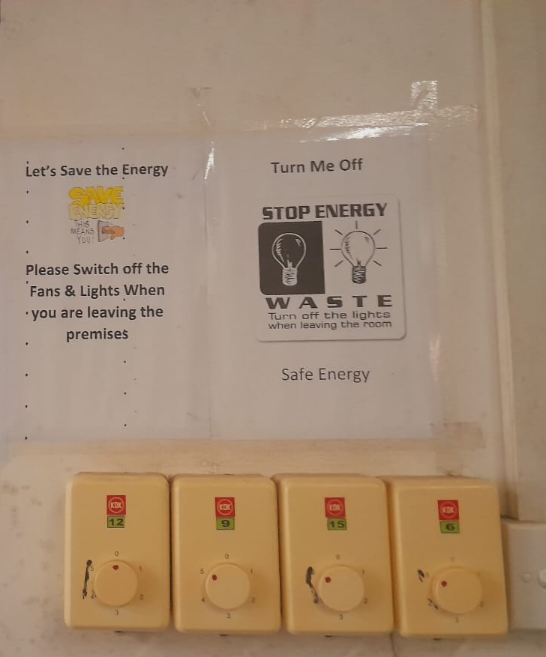
Fans left running in empty rooms waste energy and contribute to discomfort. Our project aim is to use a Smart Fan Control System to solve this problem. By automatically detecting occupancy and adjusting fan speed based on a specified temperature range.
Our project is motivated by the pressing need to conserve energy, particularly in Sri Lanka where electricity bills are high.

Slide 3
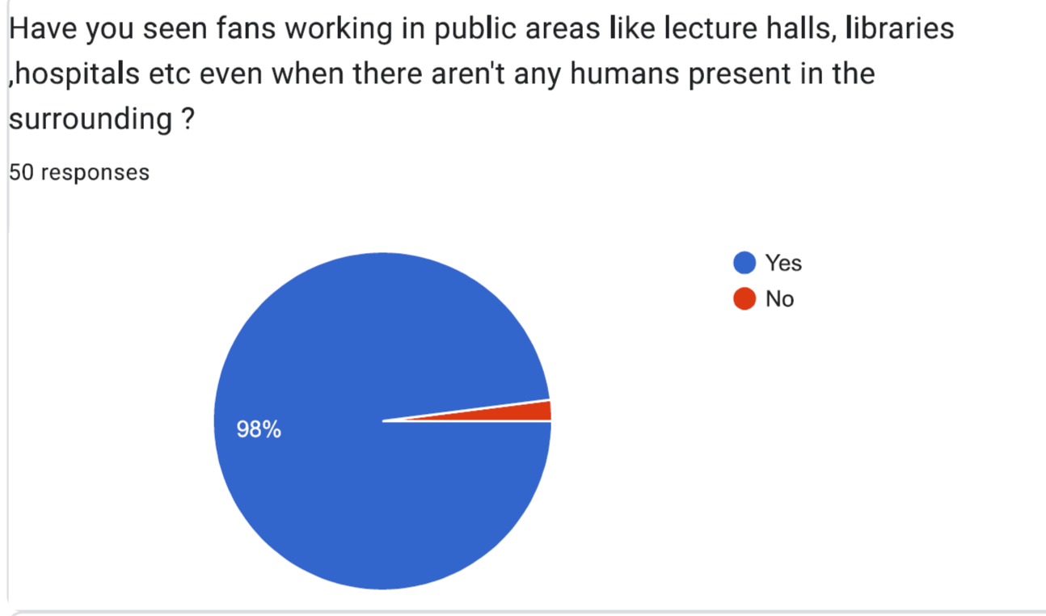
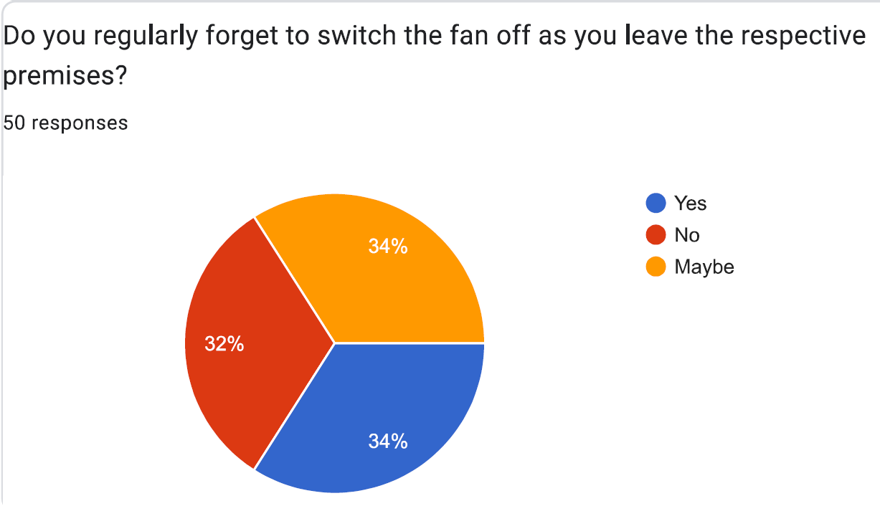
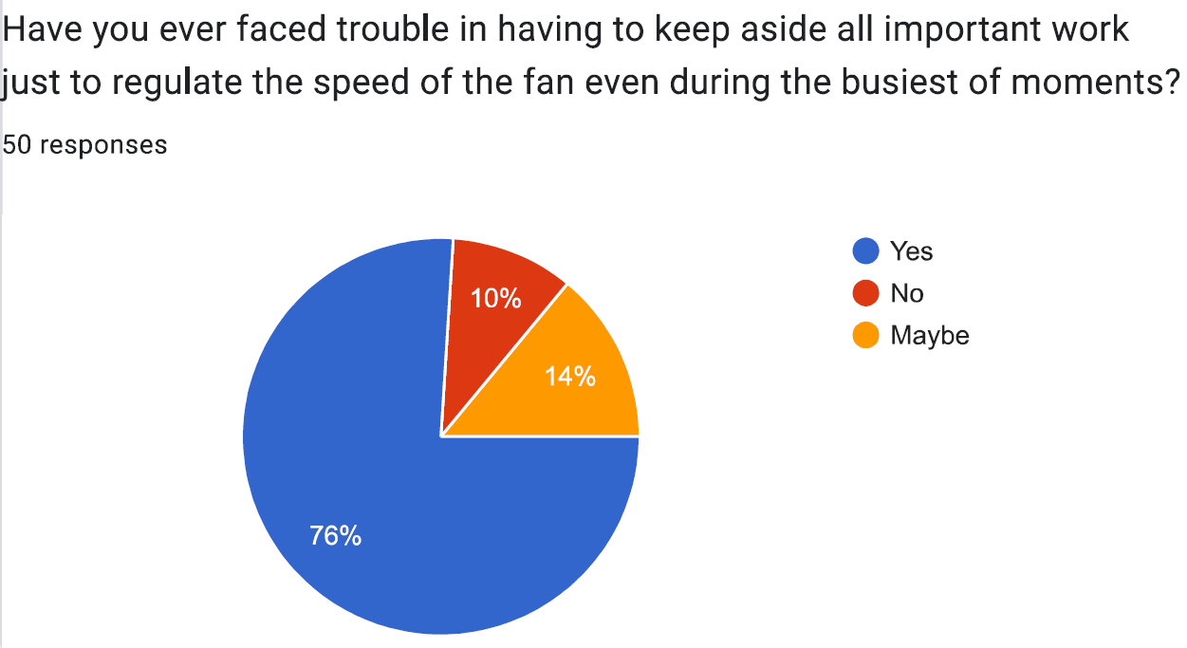
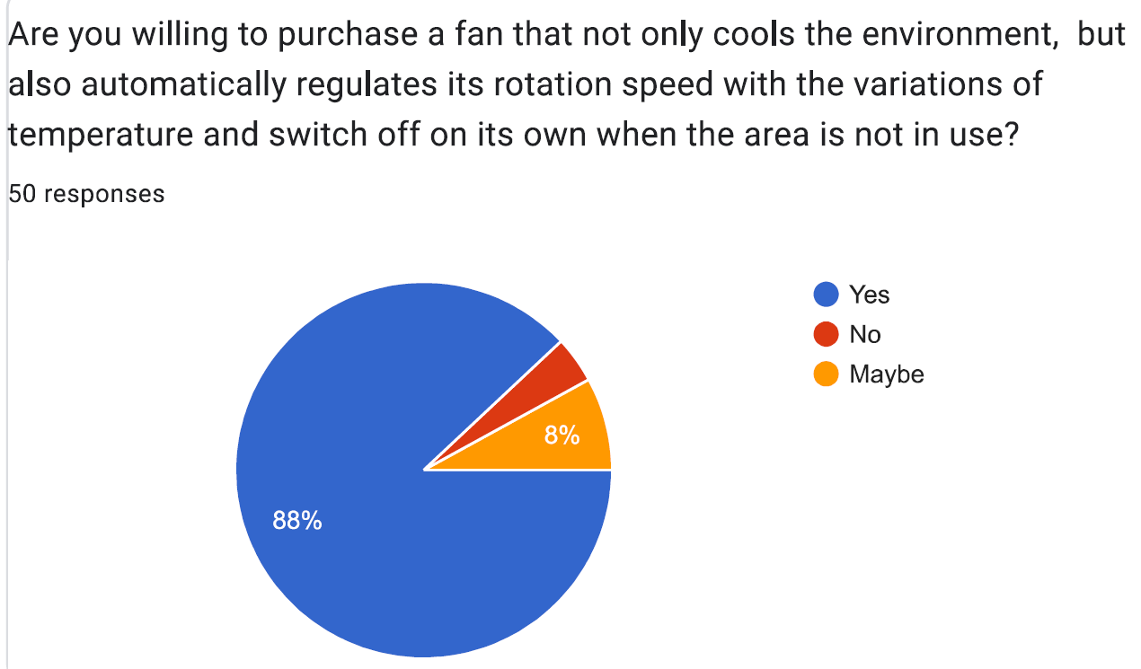

Slide 4

Justification
One typically seen sight in most public places is the working of fans even when no one is seen in the vicinity. Not only does it exhaust energy, it also leads to high electricity bills.

Slide 5
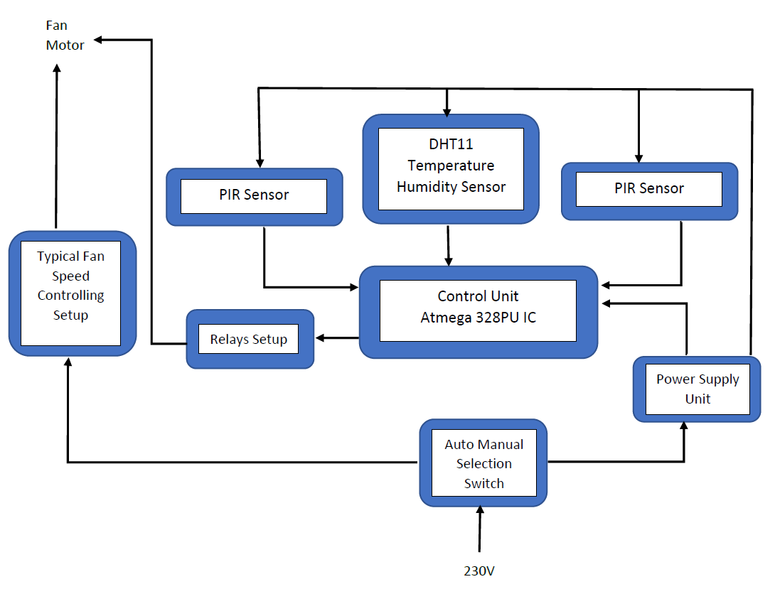
Block diagram
230V

Slide 6
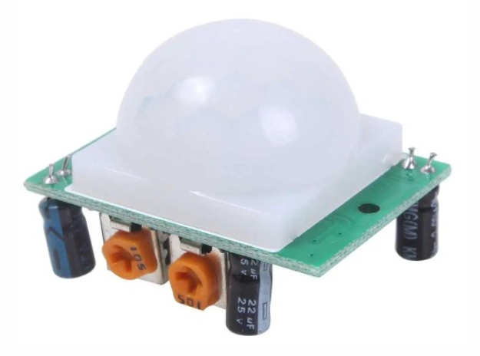
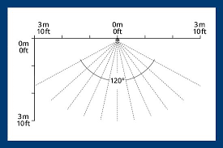
PIR SENSOR
Our objective is to detect the presence of people in a public area for that we chose the PIR Sensor. Usually in a public area like lecture halls, hospital we can capture human motion. PIR sensors can capture those kinds of motion.
The angle of the PIR sensor is 120 degrees and the range of the sensor is 2 to 7 meters.

Slide 7
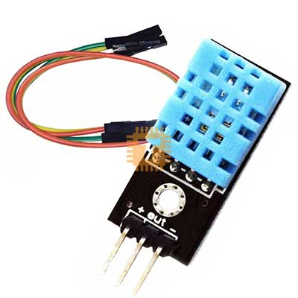
TEMPERATURE SENSOR
Our module has to regulate the speed of the fan according to the heat inside the room. Mainly the heat of a place affected by the temperature. Through this module, we can have these data to make decision to regulate the speed of the fan.
DHT11 Temperature / humidity sensor

Slide 8
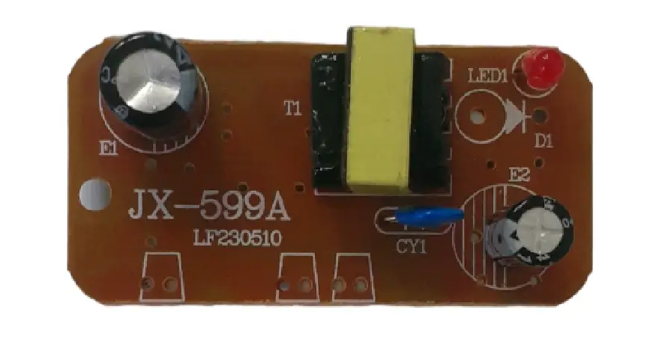
AC to DC 5V power supply
We use this power-supplying module to power up the PCB. This converts 230V AC voltage into 5V DC voltage. This has the capability to deliver upto 1A current which has the capability of powering up the microcontroller and the sensors.

Slide 9


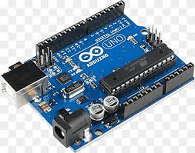

We plan to use locally available motion sensors (PIR sensors), temperature sensors (DHT11), microcontrollers (Atmega 328P), and other passive components(Resistors, Capacitors, …) to implement the Smart Fan Control System. We can use LTSPICE software to simulate the Atmega328P microcontroller and ALTIUM DESIGNER to PCB design. To build up a prototype we use Arduino uno board as well.

Slide 10
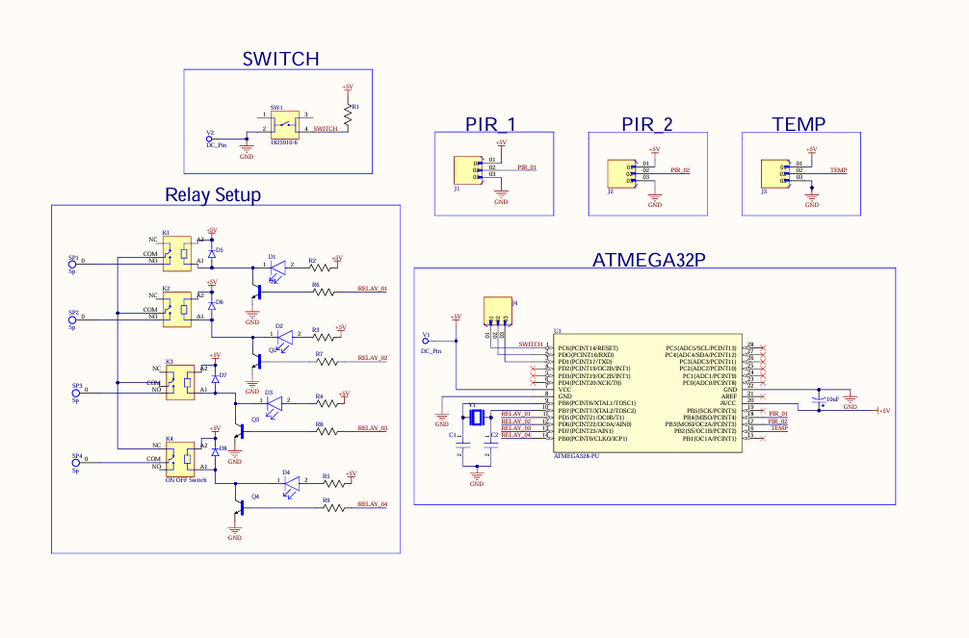
Schematic Diagram Drawn in Altium

Slide 11
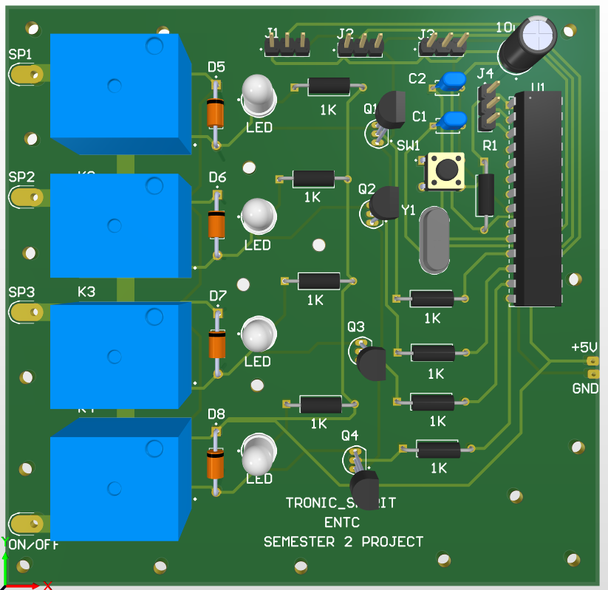
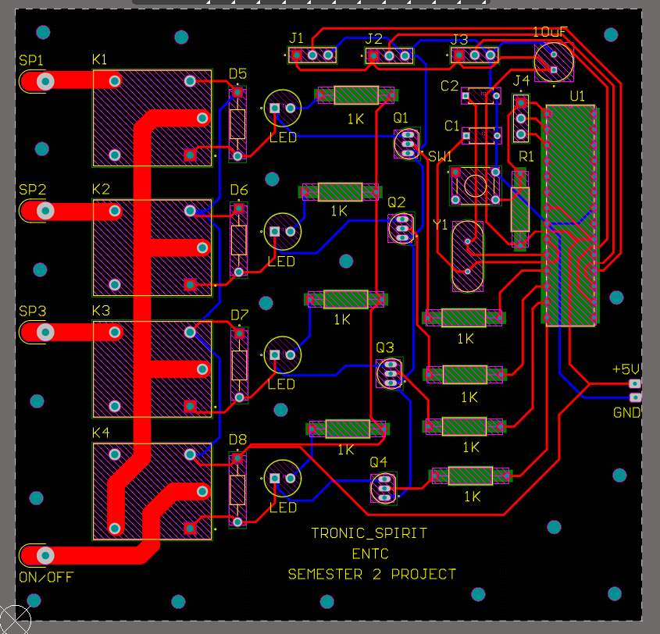
PCB Design

Slide 12
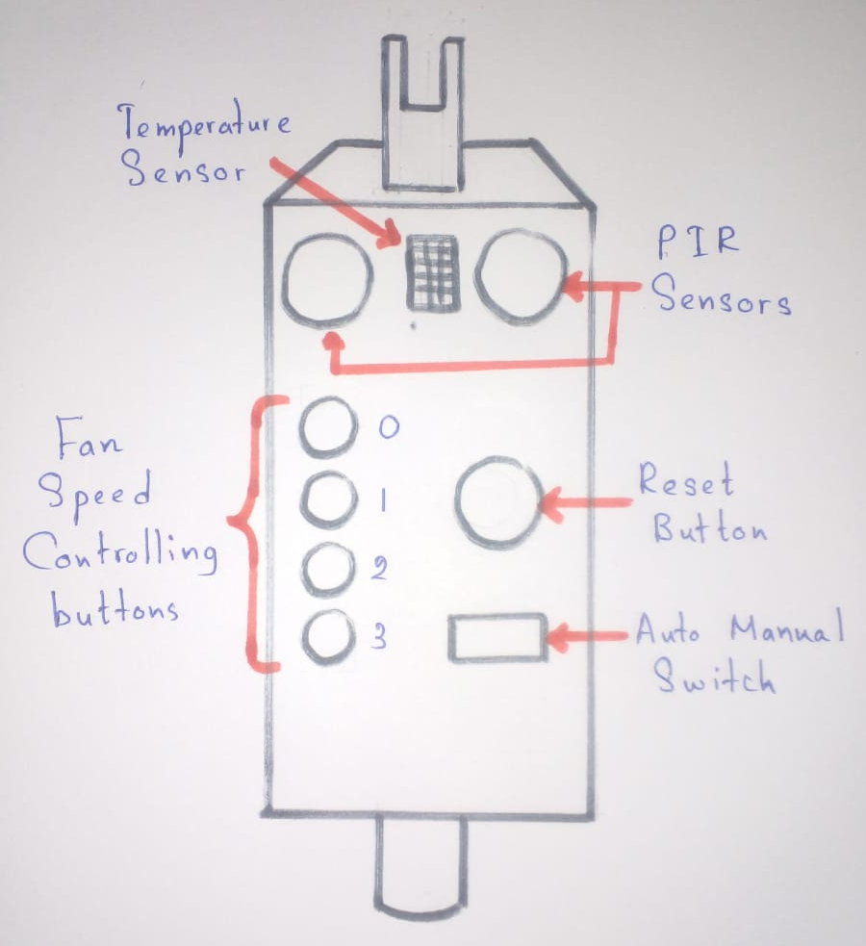
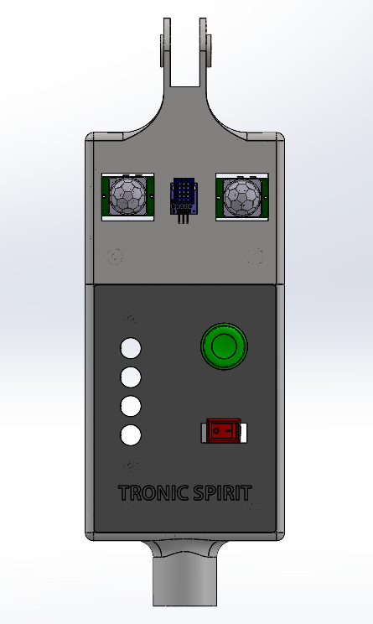
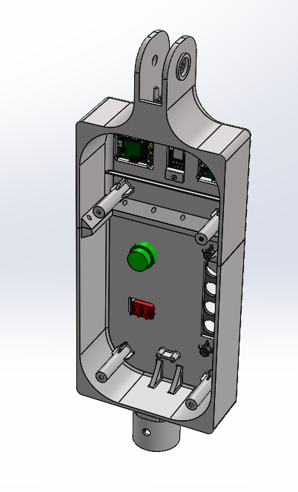
Initial and finalized sketches of product Enclosures
Final sketch
Initial sketch

Slide 13
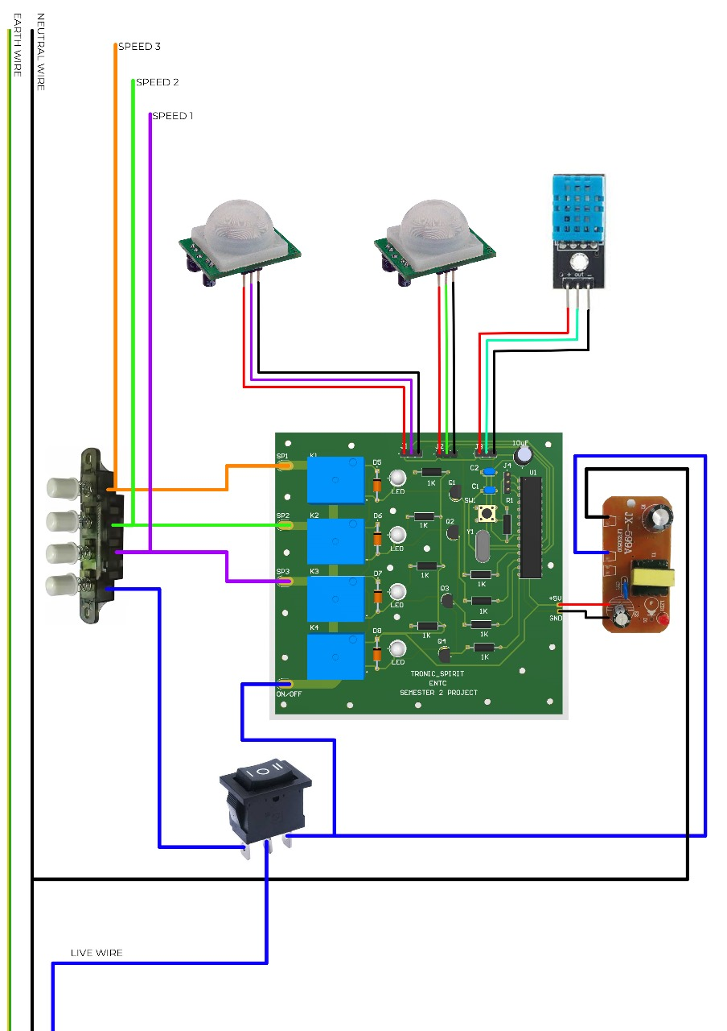
Wire connections to the PCB
This shows the wire configuration inside the module. This shows all the wires connected to the PCB, to the manual fan speed controlling buttons and to the fan motor.

Slide 14
POWER CONSUMPTION
Temperature Sensors(DHT11) -0.2mA*5V =1mW PIR Sensor -0.125mA*5V*2 =1.25mW ATMEGA328P(in active mode) =1.5mW Relay-0.45mW*5 =2.25mW 220VAC to 5VDC Converter Module =3.5 W
Total ≈3.5W

Slide 15
Approximate Budget
Item | Prices
PIR Sensor × 2 | 700
Temperature sensor | 250
Atmega 328 PU IC | 1400
Other passive components | 1000
Enclosure | 8900
PCB | 4000
Total | 16250

Slide 16
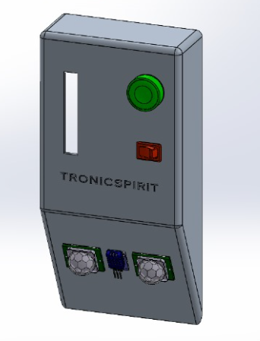


In our upcoming projects, we plan to modify the standard fan controller and also expand our project to include wall-hanging fans, as shown in the accompanying image. This will allow us to reach a broader audience and appeal to customers with different preferences.
Our marketing plan is to collaborate with industry-leading fan suppliers to integrate our Smart Fan Control System with their products. By partnering with established companies in the fan industry, we aim to introduce our product to a wider audience.

Slide 17

Task Allocation
Circuit Design
PCB Design
Product Enclosure Design
Dhawala
Dhawala
Nishitha
Malshan
Malshan
Dulavinya
Microcontroller Programming
Testing and Troubleshooting
Dulavinya
Malshan
Dhawala
Nishitha

Slide 18


